Slide 1


Retail Sales Performance & Margin Audit
Using interactive dashboards to find hidden profit leakages, review customer behaviors, and recover lost margins in Superstore sales operations.

Slide 2


Project Overview & Objectives
About the Dataset
Our Core Goals
I analyzed the Superstore Sales dataset to evaluate how the business is running. My work focused on looking closely at:
Instead of just looking at total sales, this audit was built to solve practical business questions:
▪
Transaction volumes and regional performance
▪
Find out which products are losing money
▪
Which customer segments buy the most
▪
Understand the true cost of giving discounts
▪
Why some high-sales areas are losing money
▪
Recommend easy actions to raise profits

Slide 3


Core Performance Metrics
Overall Business Health
$2.3M
The business shows solid overall performance with stable transaction growth. However, the main finding is that high top-line sales do not always mean healthy net profits.
TOTAL REVENUE
TOTAL ORDERS
TOTAL PROFIT
AVG MARGIN
10K
$286.4K
12.47%

Slide 4

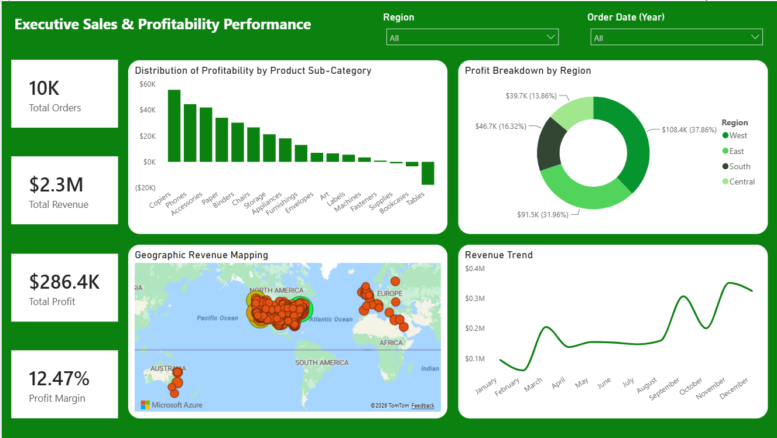
Executive Sales & Profit Performance
Regional Performance Gaps
The main dashboard reveals that profit is not distributed evenly across different regions.
Key Highlights:
•
The West Region is the most profitable market, generating 37.86% of total profits.
•
The Central Region is underperforming, bringing in only 13.86% of our profits.
•
Copiers and Phones are highly profitable, while Tables and Bookcases are actively losing money.

Slide 5
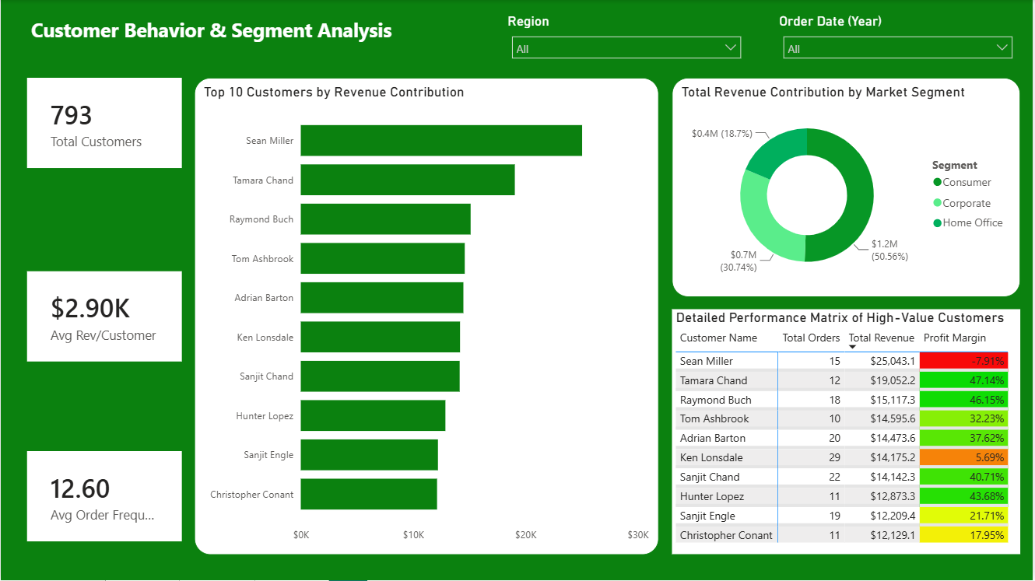
Customer Segment & Behavior Analysis
High-Volume Buyers
Understanding who buys our products helps make better sales and marketing decisions.
Key Highlights:
•
The Consumer Segment is the largest market, contributing 50.56% of total revenue.
•
There are 793 active customers who place an average of 12.60 orders.
•
Margin Warning: Some top revenue buyers, like Sean Miller, are unprofitable (-7.91% margin) due to aggressive pricing discounts.

Slide 6
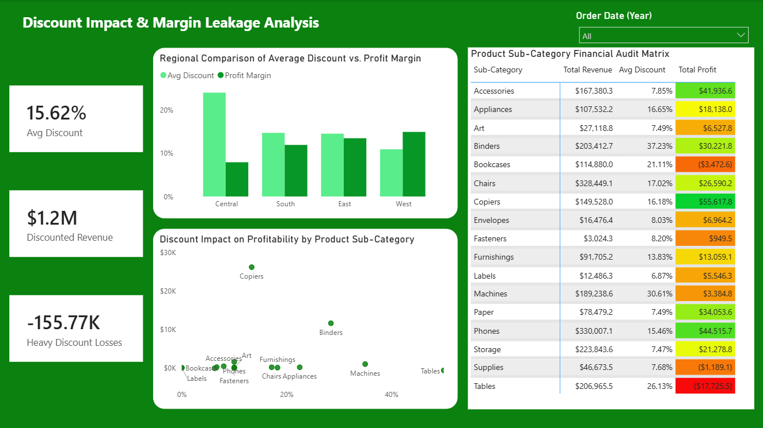
Discount Impact & Margin Leakage
The Cost of Too Many Discounts
This is the most critical part of the audit. Excessive discounts are damaging profits.
Key Highlights:
•
The average company-wide discount is 15.62%, which has caused $155.77K in losses.
•
The Central Region has the highest average discount rate and the lowest profit margins.
•
Tables are the biggest loss-maker, losing $17,725.50 due to an excessive 26.13% average discount.

Slide 7







Strategic Business Recommendations
Optimize Discounts
Product Bundling
Fix Unprofitable Accounts
Set a strict maximum discount cap of 15% on high-loss products (especially Tables and Bookcases) to protect our profit margins.
Avoid selling low-margin furniture items by themselves. Instead, bundle them with highly profitable accessories or copiers.
Review agreements with high-volume, low-profit customers (like Sean Miller) to swap flat discounts for value-based perks.

Slide 8

Project Conclusion
What We Learned
The Path Forward
This audit proves that high sales numbers do not always equal high profits. The Superstore has massive market demand, but profits are heavily leaking due to unmonitored discount practices.
By implementing the recommended discount caps and focusing sales efforts on high-margin products like Copiers and Phones, the store can recover up to $155K in lost revenue.
▪
Live dashboards can instantly highlight where money is being lost.
▪
Keep monitoring the interactive regional dashboards.
▪
Data-driven decisions prevent expensive gut-feeling sales pricing.
▪
Review customer behavior trends on a quarterly basis.

